Slide 1
Space Invaders by Team Klondike
Milestone 1: Project Pitch
ZeroEngine

Slide 2
Team Structure – Names & Justification
Game Director - Blake North
Tech Lead - Blake North
Art Lead - Adithi Arun
Design Lead - Runa Chernik
Sound & Music Lead - Tea Nguon
Producer - Ava Datsko

Slide 3
High Concept
Space invaders is a two- dimensional, single player fixed shooting game in which the player is instructed to attack the descending aliens using a laser cannon.

Slide 4
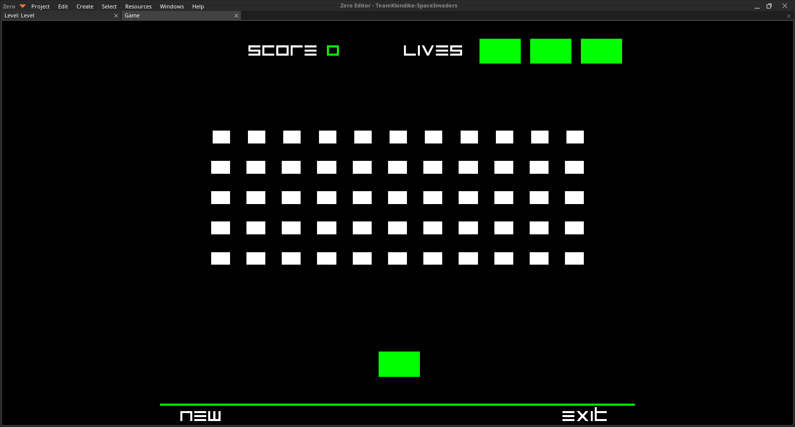
DEMO

Slide 5
Design & Features: Player
We want Space Invaders to be a fixed shooter type game
The goal is to shoot all the aliens before they get to the bottom
You will be controlling a laser gun that can be moved left and right with said arrow keys, and use the spacebar to shoot the laser
There are four evenly spaced barriers above the player to help protect them from the aliens blast. However, each time you or the aliens hit the barrier, the more damaged it gets

Slide 6
Design & Features: Aliens
The aliens will come in a rectangle of 11 by 5 and each one will be worth a different level of points
They continuously inch left or right in unison until the horde hits the side of the wall. Each time hitting the wall inches them downwards one and continues left or right
The player can use certain strategies when shooting the aliens, such as eliminating each row diagonally or horizontally
When the aliens inch closer or the more of them you shoot, the faster they and the music gets giving the player a rush of excitement and adrenaline

Slide 7
Engine & Features
ZeroEngine
Features:
Archetypes
Physics
Collision detection system
The programmers already know how to use it to a certain degree

Slide 8
Art
Pixelated, 8-bit, retro art style
Plain black background - attention on moving elements
Few, neon colors
Font stays with the space theme: blocky and narrow

Slide 9
Audio – Music & Sound
Texture: Shooting, UFO
Dramatic feel for player:
Gradual BG speed increase
Shooting
Players Death

Slide 10
Risk 1: Game Director Reassignment
Risk 1:
Addison, our original Game Director, will be on vacation from Day 2 to Day 6, and we cannot afford to have a missing Game Director for 5 days.
Mitigations
We reassigned her role to Blake (also the Tech Lead)

Slide 11
Risk 2: Dimensions of Sprites
Risk 2: Dimensions of Sprites
It proved difficult to find the precise dimensions of the characters and elements of the game to make an accurate replication.
Mitigations
Mitigation 2a. We will try searching on official web pages for Space Invaders to look for the dimensions
Mitigation 2b. If we are unable to do so before the completion of the Beta version, we will eyeball the dimensions of them and work in trial and error until the sprite works with the coding

Slide 12
Risk 3: Enemy Movement
Risk 3: Enemy Movement
I am not sure how to make the enemies step across the screen
Mitigations
I will look at tutorials for other engines
If that fails, we will talk to Ryan

Slide 13
Team Schedule

Slide 14
Week One | Blake North Game Director | Adithi Arun Art Lead | Runa Chernik Design Lead | Ava Datsko Producer | Blake North Tech Lead | James Tech | Tea Nguon Sound + Music Lead
 | ART | ART | ART | ART | TECH | TECH | AUDIO
1/31 | Game Research Presentation Prep | Game Research Presentation Prep | Game Research Presentation Prep | Game Research Presentation Prep | Game Research Presentation Prep | Game Research Presentation Prep | Game Research Presentation Prep
2/19 | Version control | Saving pre existing files + starting on Sprites | Refining Presentation | Reworking schedule due to weather problems | Version control | Figuring out values | Character Sounds
2/20 | (Presentation) | Sprites (Presentation) | Learn Mech (Presentation) | - (Presentation) | Learn mech (Presentation) | Learn Mech (Presentation) | Music (Presentation)
2/21 | Overseeing (any needed art assistance) | Drawing sprites for beta | Organization Documentation | Reviewing and Managing Budget | Script work | Script work | Music
2/22 | Overseeing (any needed art assistance) | Drawing Sprites for beta | Organization Documentation | Reviewing and Managing Budget | Script work | Script work | Music

Slide 15
Week Two | Addison Knapman Game Director | Adithi Arun Art Lead | Runa Chernik Design Lead | Ava Datsko Producer | Blake North Tech Lead | James Tech | Tea Nguon Sound + Music Lead
 | ART | ART | ART | ART | TECH | TECH | AUDIO
2/25 | Overseeing (any needed art assistance) | Drawing Sprites for beta | Organization Documentation | Reviewing and Managing Budget | Script work and polishing | Script work and polishing | Game Testing/worker bee
2/26 | Overseeing (any needed art assistance) | Drawing Sprites for beta | Organization Documentation | Reviewing and Managing Budget | Multiple levels | Multiple levels | Game Testing/worker bee
2/27 | Overseeing (any needed art assistance) | Drawing Sprites for release candidate | Organization Documentation | Reviewing and Managing Budget | Polishing | Polishing | Game Testing/worker bee
2/28 | Overseeing (any needed art assistance) | Drawing Sprites for release candidate | Organization Documentation | Reviewing and Managing Budget | Polishing | Polishing | Game Testing/worker bee
3/1 | Final Presentation | Final Presentation | Final Presentation | Final Presentation | Final Presentation | Final Presentation | Final Presentation

Slide 16
Budget and Materials Request
Research items:
Space Invaders Wiki
Space Invaders
Software:
Piskel
Zero Engine
GitHub/Git
Audacity
Equipment
Computers

Slide 17
Thank you!
Space Invaders
by
Klondike
CONTACT:
Ava Datsko
ava.datsko@digipen.edu
avadatsko@outlook.com

